Slide 1
Using Recommender System and Web 2.0 tools for Blended Learning
Department of Informatics, University of Rijeka
Radmile Matejčić 2, 51000 Rijeka, Croatia
http://www.inf.uniri.hr
Nataša Hoić-Božić, Martina Holenko Dlab
Division of multimedia systems and e-learning

Slide 2
Introduction
Work in the context of the research project "E-learning Recommender System"
developing didactical models for realization of e-learning supported by Web 2.0 tools and ELARS
UNIRI-developed contemporary blended learning model
Research published in the paper:
Hoić-Božić, Nataša; Holenko Dlab, Martina; Mornar, Vedran. Recommender System and Web 2.0 Tools to Enhance Blended Learning Model. IEEE Transactions on Education (Early Access Article)

Slide 3
Background: new e-learning trends

Slide 4
Traditional e-learning
Content-centric course design approach and standard LMS are no longer meeting the student preferences and needs
Typical actions:
learning from online materials,
taking online quizzes,
handing in homework solutions and projects,
communicating with the instructor

Slide 5
E-learning 2.0 – the influence of Web 2.0
Pedagogical aspect
Collaborative learning based on constructivist approach - students in the centre of the learning process
E-learning activities (e-tivities) - interaction of student with other students and with the teacher with the help of the learning environment
Technological aspect
Decentralized learning environments
LMS + Web 2.0 tools
PLE (Personal Learning Environment)

Slide 6
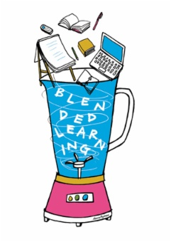
UNIRI-developed contemporary BL model
BL model consists of:
a sequence of (collaborative) e-tivities
Web 2.0 tools for their realization
ELARS recommender system
Combining LMS with Web 2.0 tools and ELARS system for personalization of e‑learning process
Evaluating whether the model increases a student’s effectiveness in e‑tivities

Slide 7
ELARS Recommender System

Slide 8
ELARS - E-Learning Activities Recommender System
Personalization of collaborative e-tivities performed using Web 2.0 tools
Recommendations for students and groups before and during e-tivities:
optional e-learning activities
collaborators (student peers)
Web 2.0 tools
advice

Slide 9
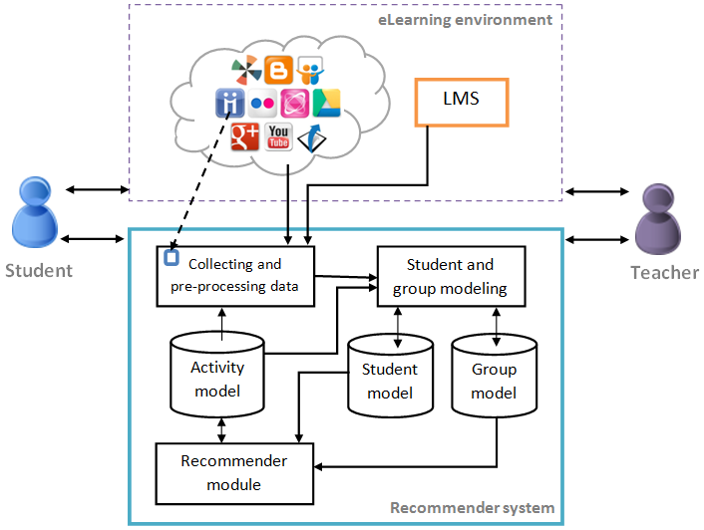
ELARS structure

Slide 10
ELARS web application and demo
http://elars.uniri.hr/Elars/
http://elars.uniri.hr/Elarsdemo

Slide 11
Example: Web 2.0 tools recommendations

Slide 12
Research methodology

Slide 13
Research
Main aim of the research: to evaluate the effectiveness of the proposed blended learning model within an e-course „Hypermedia Supported Education”
E-tivities designed to allow students achieving the learning outcomes
Hypothesis: Students who performed personalized e-tivities supported in the ELARS recommender system achieve better final results in e‑courses.

Slide 14
Participants
senior students in the graduate program in the Computer Science major in the Department of Informatics
The control group: students who took the course in 2012/2013 (N=16)
The experimental group: the students who took the course in 2013/2014 (N=21)

Slide 15
Course learning modules with activities
The learning design for the e-course includes a sequence of activities grouped in learning modules taught in a sequential blended way

Slide 16
Activities workflow in the learning module LM₃

Slide 17
Course activities and grading points
Module | Activity | ECTS* | Tools | Points (max)
LM₁-LM₇ | Participating in e-course | 1 | MudRi and ELARS | 10
LM₂ | Seminar 1: ICT in education | 0.5 | Blogger/Google Drive/ Wikispaces | 15
LM₃ | Mind mapping | 0.5 | MindMeister | 10
LM₄ | Wiki | 0.5 | Wikispaces | 10
LM₅ | Seminar 2: Web 2.0 tools in education | 1 | Google Drive /Wikispaces/ SlideShare | 20
LM_{3,} LM₇ | Revision | 0.5 | Diigo/Google Drive/ Google+/MindMeister/Wikispaces/YouTube | 5+5**
LM₆ | Theory exam | 1 | MudRi | 30
 | Total: | 5 |  | 100+5**

Slide 18
Descriptive Statistical Analysis
 | Control group | Experimental group
N Minimum Maximum Mean Median Standard deviation Inter quartile range Coefficient of quartile deviation | 16 55 96 78.6 79 8.8 8.5 0.05 | 21 79.5 96 89.2 89.5 4.5 7.38 0.04

Slide 19
Comparison of e-tivities results
E-tivity | Control group | Experimental group | p
Seminar 1 Discussion/Mind mapping Wiki Seminar 2 | 62.5 60.31 80.63 85 | 90 86.91 89.76 92.5 | <.0001* .0067** .0073*** .1737*
*Mann-Whitney U test **Welch test ***Student’s t-test

Slide 20
Anonymous questionnaire results
Questionnaire statements | Avg | StDev
You are satisfied with course learning model which is based on collaborative e-learning activities (e‑tivities). You consider applied learning model effective. You find positive the freedom to choose between optional e-tivities, collaborators and tools for e-tivities within the course. You consider Web 2.0 tools useful for realization of e-tivities. You consider ELARS recommender system useful for e-activities. You believe that the use of ELARS recommender system positively affected the level of your engagement during e-tivities. | 4,30 4,30 4,70 4,60 3,76 3,44 | 0,49 0,49 0,47 0,49 0,93 0,86

Slide 21
Conclusion and future plans
The evaluation results confirm the effectiveness of proposed model in a real setting and student satisfaction with it
Future plans
recommendations algorithms improvements
improvements of ELARS authoring component for teachers
creating and evaluating didactical models for the use of Web 2.0 based e-tivities in different types of blended and online higher education e-courses

Slide 22
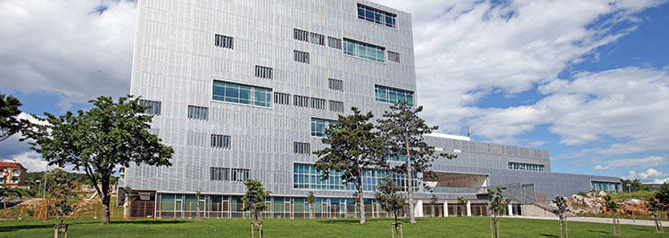
Thank you for your attention!
www.inf.uniri.hr
natasah@inf.uniri.hr
mholenko@inf.uniri.hr

